Slide 1
VASICEK FIXED INCOME MODELLING
By Ashara Dangallage Don

Slide 2
Fixed Income Modelling & Monte Carlo Pricing
Queen Mary University of London
C++ implementation covering curve construction, Vasicek modelling, validation, and sensitivity analysis
What was built
Final validation snapshot
Semi-annual swap-curve bootstrap using linear interpolation of discount factors
Vasicek term-structure analytics: discount factors, spot rates, and forward rates
Monte Carlo pricing for a 5Y zero-coupon bond, a short-rate call, and a bond call
Sensitivity sweep over mean reversion a and volatility σ
5Y zero-coupon bond: passes the 0.1% relative SE target
Bond call: passes the 1% relative SE target
Short-rate call: above the 1% target at the chosen run size
Main takeaway: framework is stable, but the rate option would need a larger simulation budget for tighter precision

Slide 3
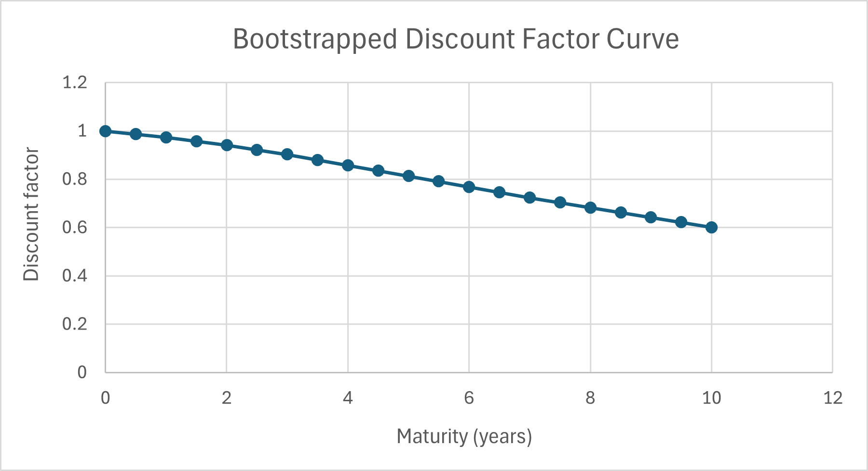
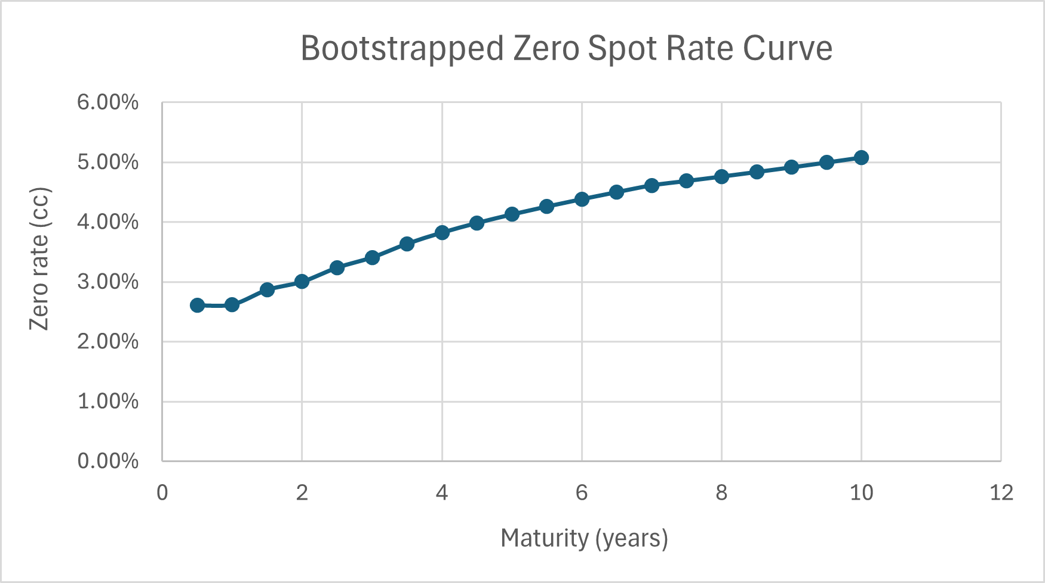
Q1 - Market Curve Construction
Bootstrapped from semi-annual par swap quotes (1Y to 10Y). The discount factor curve is monotone and the zero spot curve is upward-sloping, which is consistent with the input term structure.
Bootstrapped discount factor curve
Bootstrapped zero spot curve (continuously compounded)
Headline checks: 1Y ZCB = 0.9741 | 2Y zero rate = 3.0033% | 7Y swap @ 4.42% reprices negative | 9Y par swap rate = 4.8309%

Slide 4
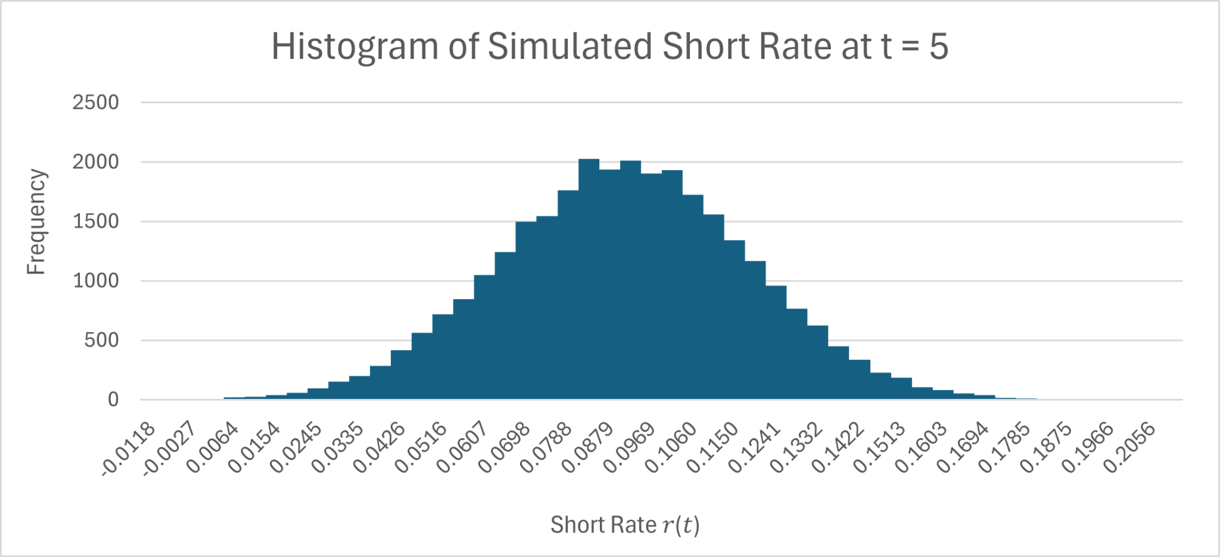
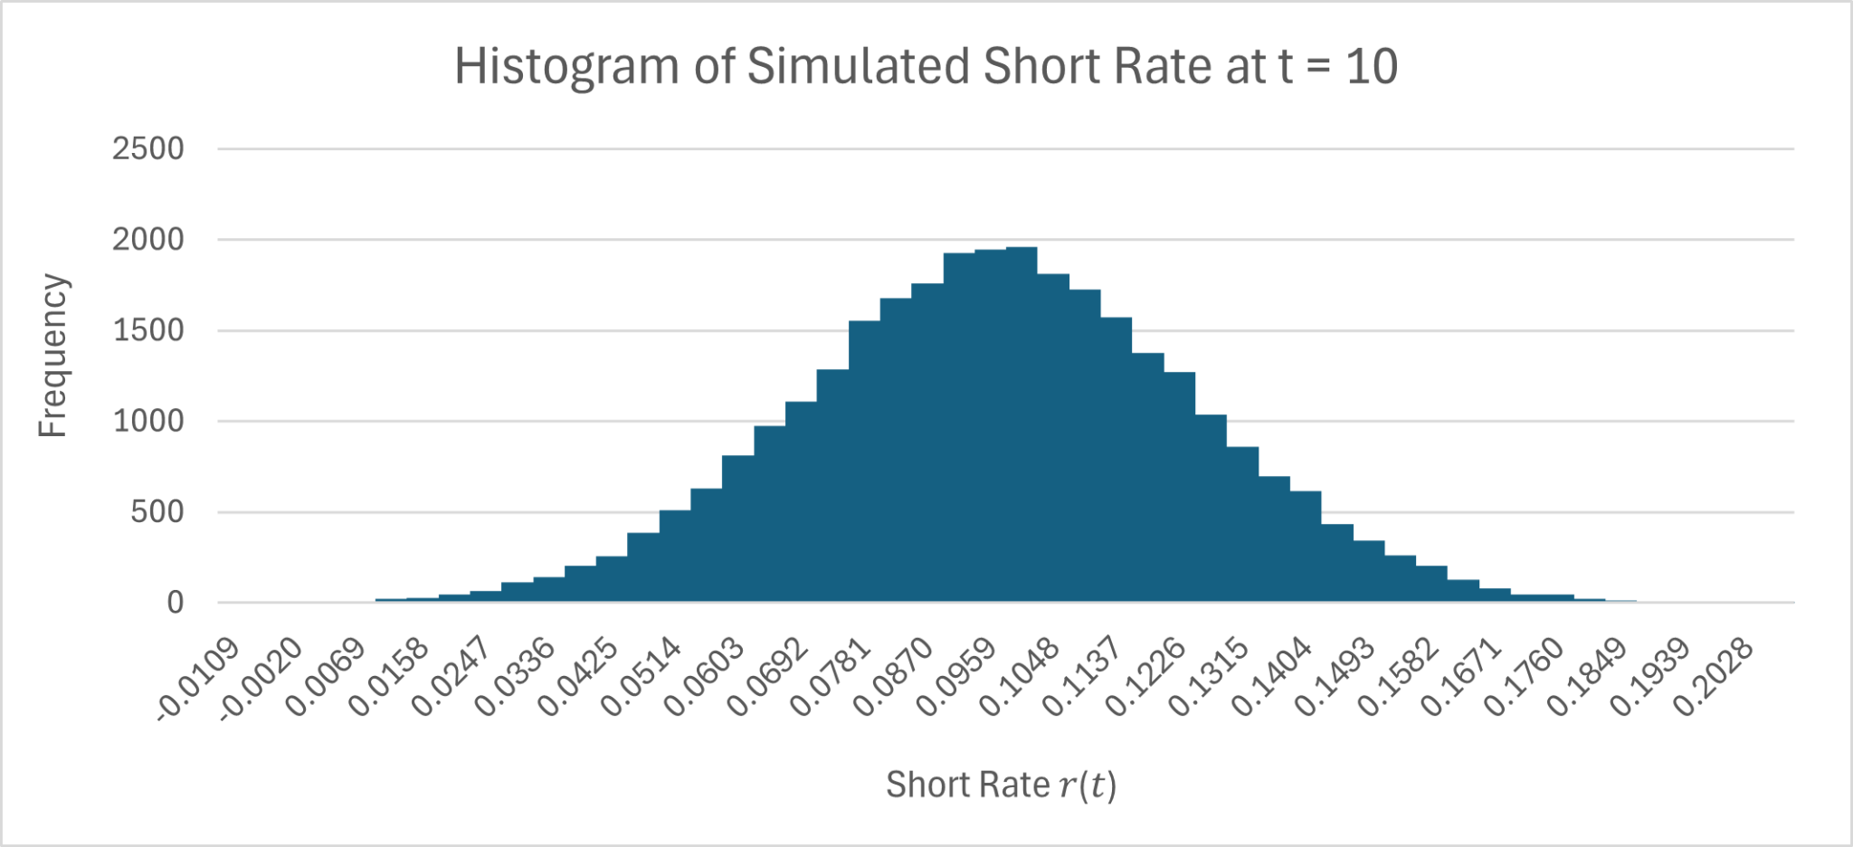
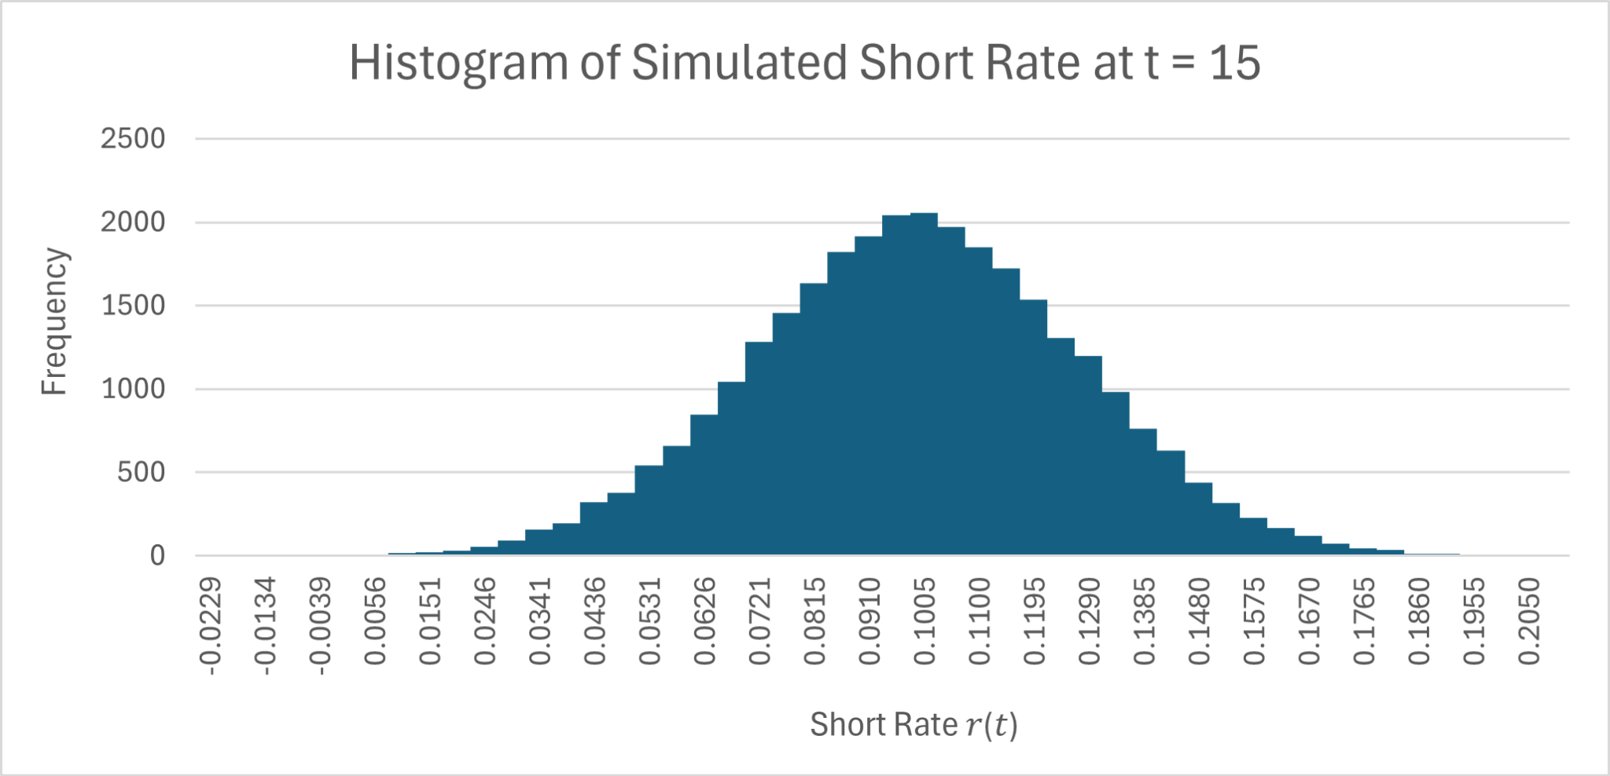
Q2 - Simulated Short-Rate Distributions
Representative histograms at 5, 10 and 15 years. The center of the distribution moves toward the long-run mean b = 10%, while the shape remains broadly Gaussian under Vasicek.
t = 5
t = 10
t = 15
Mean short rate rises from roughly 7.68% at year 1 toward 9.93% by year 15
The model allows some negative short-rate outcomes because Vasicek is Gaussian
These plots are useful as a distribution check rather than a calibration claim

Slide 5
Validation and Convergence Check
The table below shows where the implementation met the target precision and where it did not.
Instrument | MC price | Std. error | Rel. error | 95% CI | Exact / benchmark | Abs. diff
5Y zero-coupon bond | 0.664023 | 0.001049 | 0.158% | [0.661967, 0.666080] | 0.663139 | 0.000885
Short-rate call | 2452.470261 | 102.836537 | 4.19% | [2250.910648, 2654.029874] | — | —
Bond call | 0.026102 | 0.000451 | 1.73% | [0.025218, 0.026986] | — | —
The 5Y zero-coupon bond tracks the analytical price closely, but this specific table is above the original 0.1% target.
The short-rate call is the least precise estimate here and would need a materially larger path count to push the relative SE below 1%.
The bond call is much tighter, but still above 1% in this final table.

Slide 6
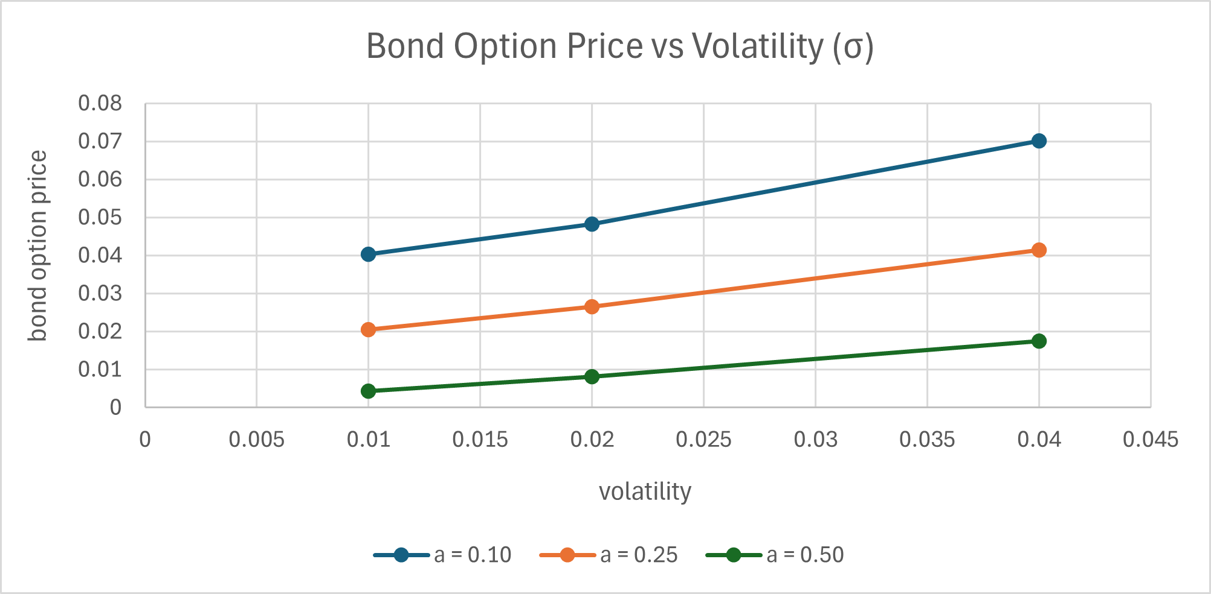
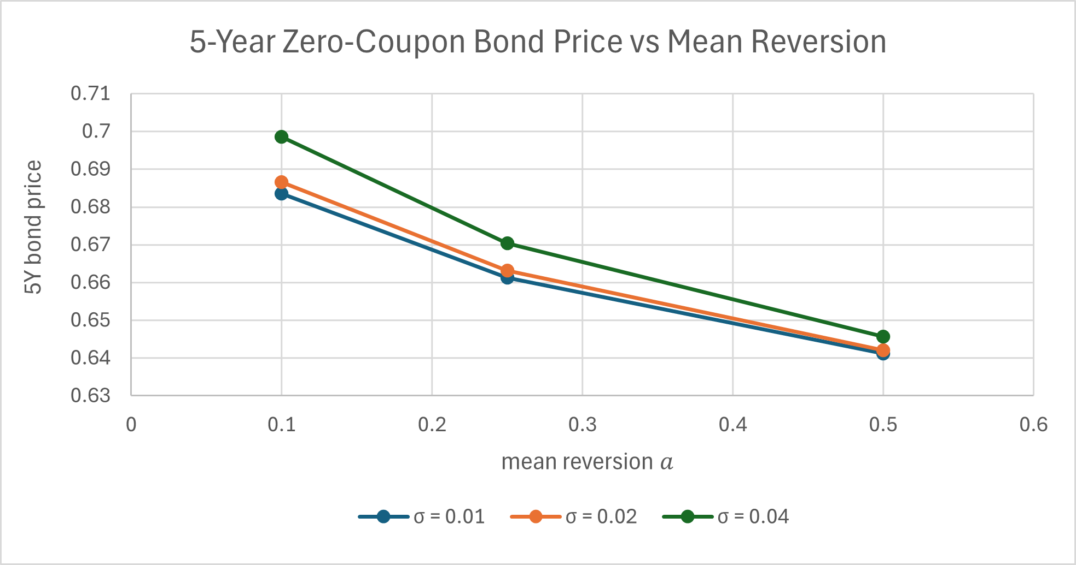
Sensitivity Analysis
Scenario grid used in code: a ∈ {0.10, 0.25, 0.50}, σ ∈ {0.01, 0.02, 0.04}
Bond option price vs volatility
5Y zero-coupon bond price vs mean reversion
Higher σ lifts bond option values across all a settings, which is the expected convexity effect.
Higher a lowers the 5Y bond price in this setup by pulling rates back toward the long-run mean more quickly.
At a fixed a, larger σ partly offsets that price drop because added uncertainty raises the bond value in these scenarios.

Slide 7
Implementation Choices and Risk Controls
Curve bootstrap uses linear interpolation of discount factors between quoted maturities.
The short-rate simulation uses the exact Vasicek transition rather than an Euler step.
Discounting along each path is done with a trapezoid approximation to the short-rate integral.
The workflow reports standard error, relative error and 95% confidence intervals.
Randomness is seeded to keep runs reproducible during review.
Base configuration
a = 0.25 | b = 0.10 | σ = 0.02 | r0 = 0.07
dt = 1/252 | seed = 1234
n_paths_hist = 30,000
n_paths_bond = 30,000
n_paths_opt = 30,000
n_paths_sensitivity = 10,000

Slide 8
Model Risk, Limits and Next Steps
Known limits
What is still useful
Natural extensions
Vasicek is Gaussian, so negative short rates can appear.
This is a one-factor model, so curve-shape flexibility is limited.
There is no market calibration step in this version.
The build is transparent and reproducible.
It shows the full chain from market curve to pricing outputs.
The sensitivity grid gives a clean way to discuss directional risk.
Increase path budgets adaptively by target error.
Calibrate parameters to market instruments.
Compare against an alternative model such as CIR.

Slide 9

QUESTIONS?

